Slide 1
GPT-based Language Model for Text Generation
Sujal Gyawali Sujan Gyawali Sachin K.C.

Slide 2
Objective
Implement Transformer Architecture: To build a language model based on the Transformer architecture, incorporating multi-head self-attention and feedforward layers.
Text Generation: To train the model on a text corpus and evaluate its ability to generate text based on an initial prompt.
Training and Evaluation: To monitor training performance and evaluate the model’s loss on both the training and validation datasets.
Model Saving/Loading: To implement functionality for saving and reloading the trained model for further use.
Notes:
1.7.2013
2
‹#›

Slide 3
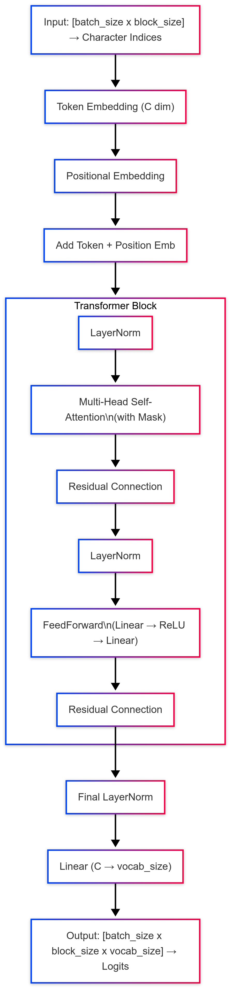
Model Architecture

Slide 4
Model Architecture
Input : I love dogs
Tokenization (character-level): ['i', ' ', 'l', 'o', 'v', 'e', ' ', 'd', 'o', 'g', 's']
Token IDs (example): [15, 1, 43, 47, 54, 39, 1, 37, 49, 41, 53]
Shape: [1, 11] → (batch size = 1, sequence length = 11)
Token Embedding:
Each token ID is mapped to a learnable 384-dimensional vector.
Shape after embedding: [1, 11, 384]
What it captures: 🔸 Semantic meaning of each token 🔸 Same word always gets same vector (before training)

Slide 5
Model Architecture
Positional Encoding: It add a new dimension for each position in sequence
Shape: [11, 384] → broadcasted to [1, 11, 384]
What it captures: 🔸 Positional information (order of tokens) 🔸 Tells the model the "location" of each token
Combined Embedding:
x_emb = token_emb+pos_emb
What it contains: Meaning of the token (from token embedding) Position of the token (from position embedding)

Slide 6
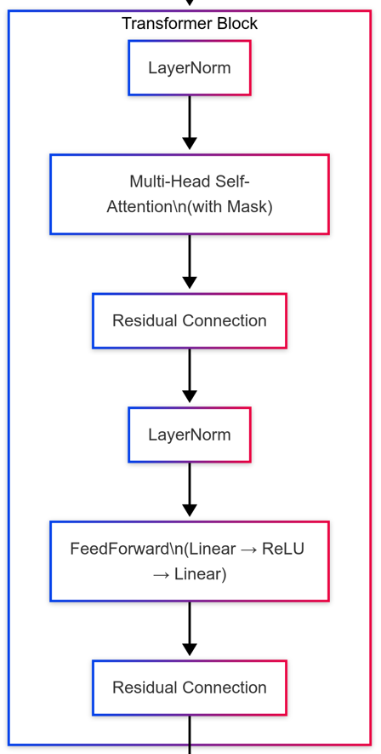
Model Architecture

Slide 7
Model Architecture
Input to Block: Shape [1, 11, 384] (Token + Positional embeddings for a sequence of 11 tokens)
Multi-Head Self-Attention
Split Embedding into Heads: Input of size 384 split across 8 heads → each gets 48 dimensions. Shape for each head: [1, 11, 48]
Compute Q, K, V: Use learned linear layers to project input into Query (Q), Key (K), and Value (V) vectors for each token.
Scaled Dot-Product Attention: Compute attention weights using: Attention = softmax(Q × Kᵀ / √d_k) (where d_k = 48, the head dimension)
Apply Attention to Values (V): Output for each head: context-aware representations.
Concatenate Heads: All heads' outputs combined → shape becomes [1, 11, 384]
Final Linear Projection: Merge attention information using a linear layer.

Slide 8
Model Architecture
Residual Connection + LayerNorm (Post-Attention)
Add the original input to the attention output (residual connection).
Apply Layer Normalization to stabilize training.
Shape remains [1, 11, 384]
FeedForward Neural Network (FFN)
Pass each token’s vector through:
Linear Layer: 384 → 1536
ReLU Activation
Linear Layer: 1536 → 384
Introduces non-linearity and richer transformations.
Optional Dropout applied during training.
Residual Connection + LayerNorm (Post-FFN)
Add the input of FFN to its output.
Apply Layer Normalization again.
Final Output Shape of Block: [1, 11, 384]

Slide 9
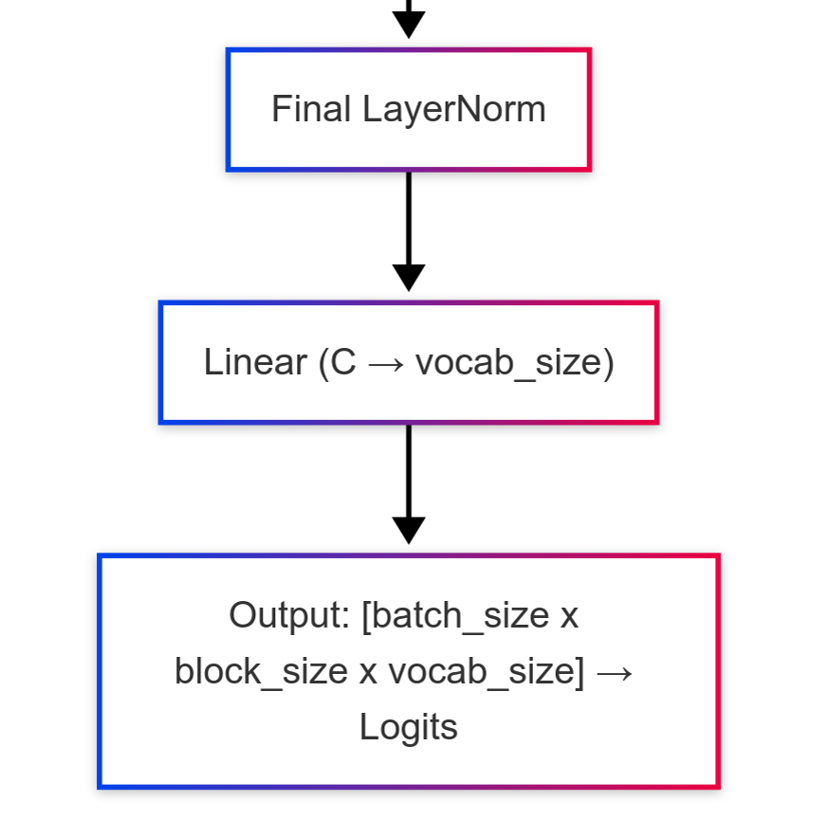
Model Architecture

Slide 10
Model Architecture
Output shape: [1, 11, 384]
Each of the 11 tokens (e.g., from "I really love cute dogs and they are funny") is now a 384-dimensional context-aware vector.
Final Layer Normalization :
Purpose: Normalize the hidden states one more time.
Shape remains: [1, 11, 384]
Linear Projection to Vocabulary:
It maps each vector from size 384 → 50257
Output shape: [1, 11, 50257]
Each token position now has a score for every word in the vocabulary
Focus on Last Token’s Output:
This gives vocabulary scores for the token after the 11th word
GPT only uses causal self-attention, so it looks at left context only.

Slide 11
Model Architecture
Shape: [1, 50257]
Tells how likely each word in the vocabulary is to be the next word.
Select Output Token:
Use argmax(probs) → greedy decoding
Or sample based on probabilities → temperature-controlled sampling
Example:
Top 3 predictions:
"." → 0.30
"too" → 0.18
"because" → 0.10
Chosen token: "."

Slide 12
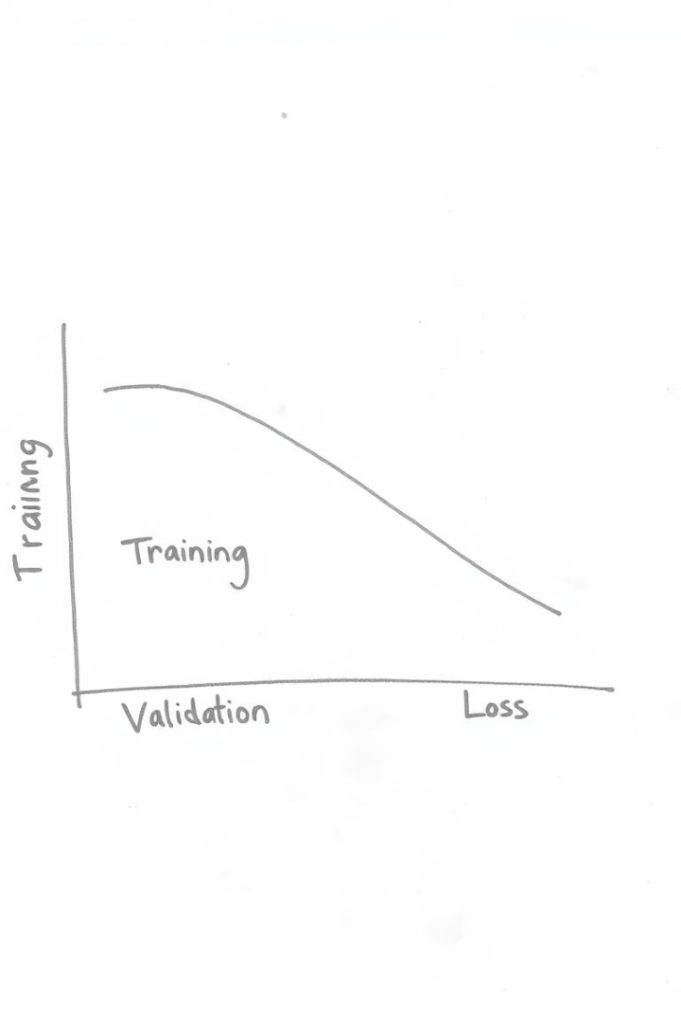
Training Process
Optimization Setup
Adam optimizer with learning rate 3e-5. Cross-entropy loss function.
Training Loop
Processed data in batches of 64. GPU acceleration via CUDA.
Evaluation & Checkpoints
Periodic loss evaluation on train/validation sets. Saved model checkpoints.
Notes:
1.7.2013
5
‹#›

Slide 13





Data Handling
Dataset Selection
WikiText-2 loaded via Hugging Face datasets library.
Preprocessing
Concatenated text from train and validation splits.
Character-level Tokenization
Built vocabulary from unique characters, mapped to integer indices.
Batching
Created fixed-length sequences (128 chars) with shifted targets.
Notes:
1.7.2013
3
‹#›

Slide 14








Text Generation
Input Sequence
Model Prediction
Provide current sequence (last 128 characters)
Get logits from model for next character
Character Sampling
Probability Conversion
Sample next character using multinomial distribution
Apply softmax to convert logits to probabilities
This autoregressive process repeats for each new character, introducing randomness for creative generation.
Notes:
1.7.2013
6
‹#›

Slide 15
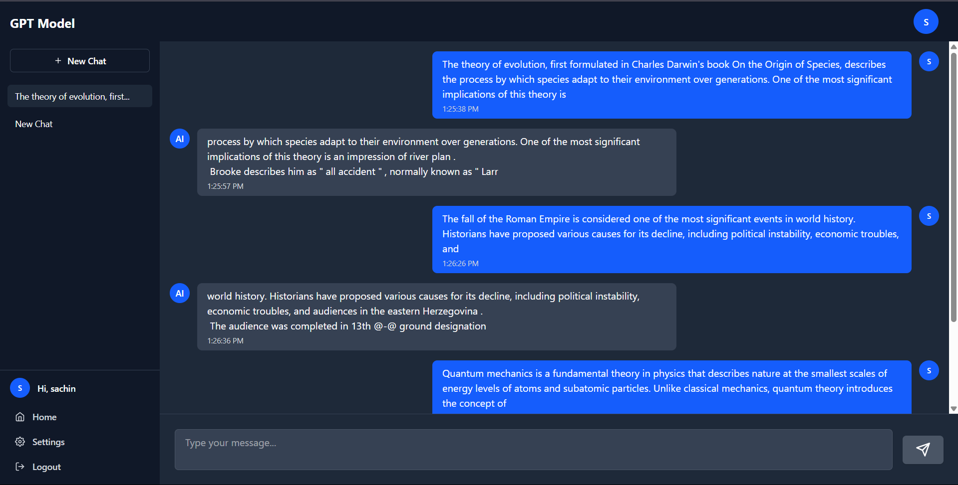
Sample Output

Slide 16
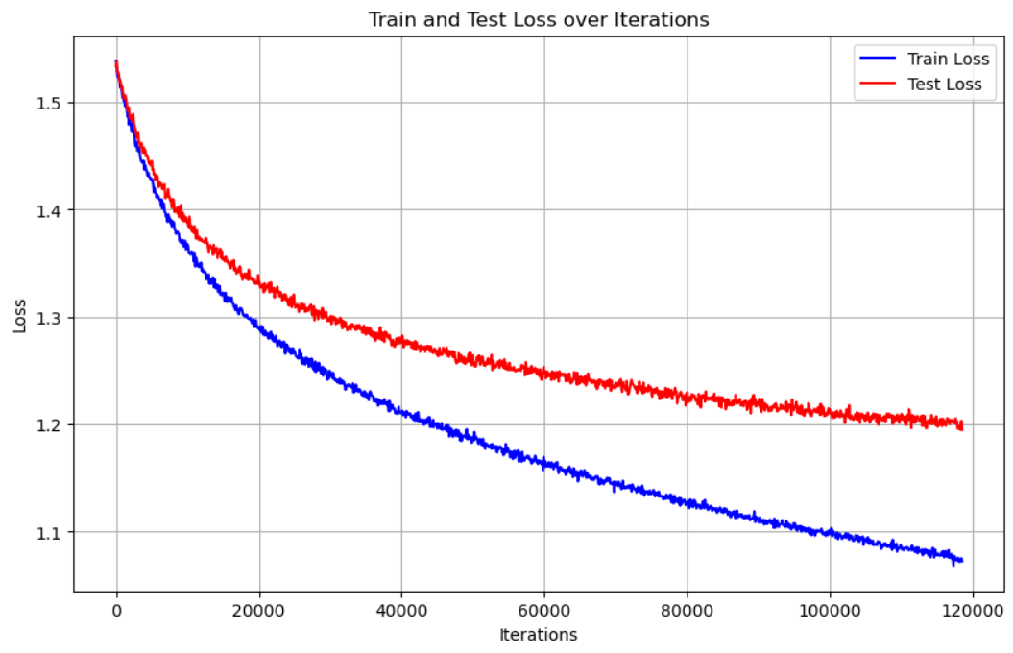
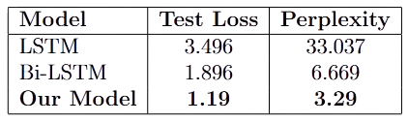
Metrics & Results
Training loss consistently decreases throughout the 150,000 iterations
Training Loss: ≈ 1.09
Test Loss: ≈ 1.19
Perplexity: e^{1.19} ≈ 3.29
Comparison with Baseline Models
Notes:
1.7.2013
7
‹#›

Slide 17
Conclusion & Future Work
Outcomes
Transformer outperformed LSTM & BiLSTM
Achieved low loss (1.19), perplexity (3.29).
Generated coherent and context-aware text
Limitations
Small dataset
Hardware constraints
Limited evaluation metrics
Future Work
Model & Dataset Scaling: Increase layers/heads; use larger or multilingual corpora
Task-Specific Fine-Tuning: Adapt model for QA, summarization, and dialogue
Efficient Training Methods: Use mixed precision, checkpointing, and pruning
Enhance Interpretability: Add attention heatmaps and visualization tools
Notes:
1.7.2013
8
‹#›

